Slide 1
Debt Portfolio
Should we purchase it?

Slide 2
Agenda
Problem Definition
Picking a Portfolio
Building Predictive Models
Evaluate the Model
Risk Mitigation

Slide 3
Problem Statement
What is it we want to accomplish?

Slide 4

Problem Statement
The economy is on the rise
Unemployment rate is at a 50 year low
Have people with debt problems become “Financially Well”?
Will they take our deal?
Can we accurately identify if a portfolio of debt is good one to purchase?
Notes:
Debt is a large problem in the United States. Many people have fallen into large amounts of debt much of which have a staggering interest rates attached to it. A significant number of these people have chosen not to repay this debt. This can be attributed to any number of reasons (loss of employment, other costs taking precedence, with the interest being so high they don't see any reduction in the principle amount, etc…) After a period of time trying to collect on the debt creditors will write this debt off and sell it in hopes of recouping some of what is owed. The process by which debt is sold comes in the form of debt portfolios i.e., a number of different debtors are bound together and sold as a percentage of the total amount owed. This could me pennies on the dollar.
Getting people who have a demonstrated propensity of ignoring their debts to pay is the key to success when purchasing portfolio s of debt. How then do we do this? It is our belief that people in this position would like a way out. Either to just have the load of the debt off their shoulders, or to get the credit back so they my buy a house, car, etc… This was implemented successfully with this portfolio by forgiving the interest and fees currently associated with the loan and reducing the interest rate to prime plus 3.

Slide 5
Picking a Portfolio
Setting Initial Filters

Slide 6
Picking a Portfolio
Debt Marketplaces
Third party providers where you can bundle portfolio’s of debt based on your filter criteria
This pre-preprocesses the data before my analysis and allows for faster purchase decision making
Initial Debt Marketplace filters
Denver metro local
Debtors must be home owners
Bankruptcy check
Prefer married couples
Remaining balance < 15k

Slide 7
Picking a Portfolio
Programmatic Filters and Feature Engineering to Create Predictors
Remaining balance
Interest and fees
Last Pay Amount
Look at the “Cycle” – How many times the loan has been sent to a collection agency
Secondary
Tertiary
Quaternary
Number of days until Out of Statute
Notes:
The first 4 items where filtered by the broker when the portfolio was requested

Slide 8
Building Predictive Models
Forecasting Outcomes

Slide 9
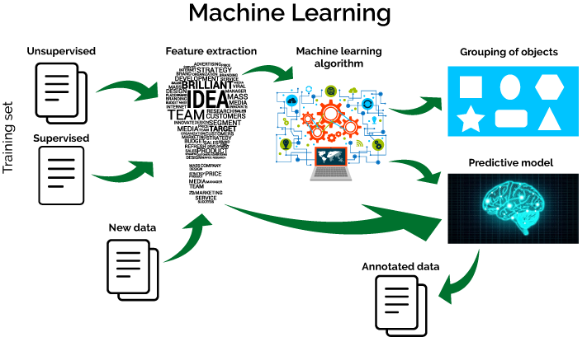
Building Predictive Models
Predictive Model or Machine Learning
Creating insights from the given data
Each model has a number of predictors
These are variables that are likely to influence future results.
Notes:
Predictive modelling is a process that uses data and probability to forecast outcomes. Each model is made up of a number of predictors, which are variables that are likely to influence future results. Once the data has been collected and cleaned a model is fitted to that data and predictions are then able to be made.

Slide 10
Evaluate the Model
Can we predict if a debt portfolio is worth buying?

Slide 11
Evaluate the Model
I was able to create a model that correctly classified 91.89% of the data.
Did someone repay their loan
What does that mean in terms of our problem statement
Can we accurately identify if a portfolio of debt is good one to purchase?

Slide 12
Risk Mitigation
Adding More Information

Slide 13

Risk Mitigation
Get an indication of the debtors “Financial Wellness”
This can be added to the models predictors and improve the accuracy of the model.

